Slide 1
fraud
Technical - Overview
Integration Team
2019

Slide 2
AGENDA
Overview
Workflow
Request/Response
Manual handling
Business and system configuration

Slide 3
“
The GPP Fraud Interface enables GPP to verify that transactions comply with all relevant anti-fraud rules and regulations as enforced by a financial institution’s external fraud interface.”
GPP Interfaces – Business Guide System Integration

Slide 4
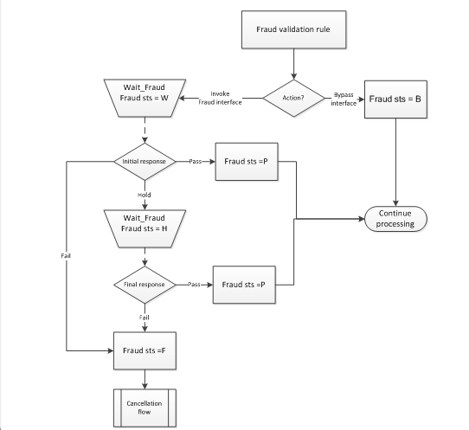
Workflow
GPP determines whether to invoke the interface using the Fraud Validation business rules. If a transaction meets the conditions of a defined rule, GPP uses the value defined in the Send Payment to field to determine whether to invoke the interface. The field can contain one of the following values: BYPASS and FRAUD1

Slide 5
SEND REQUEST flow
Wait Behaviour Wait FRAUD
Fraud
Account Lookup
Feeder
Receive Payment Instruction
Payment Initiation
Debit Side Processing
Credit Side Processing
Internet Banking, Branch-OTC, SWIFT, Local Clearing
Compliance
GPP invokes the Fraud Interface during individual transaction processing after the Message Duplicate Check flow and before invoking the Account Lookup Interface .
Rule action is derived from a pre-defined field value (where Field type is MF_FRAUD_VALIDATION_STS ).
Rule action can be set as BYPASS, indicating this transaction should bypass the Fraud check.
Addressing Inquiry
FX Engine
SWIFT, Local Clearing
Payment execution
Fees Processing
MOP Selection Value Date and Cut Offs
Available at every complete or intermediate status
Accounting System
Balance Inquiry
Advising System

Slide 6
fraud request
Level 1 | Level 2 | Level 3 | Level 4 | Level 5 | Description
FndtMsg
 | Header |  |  |  | General identifying attributes
 | Msg |  |  |  | Transaction message
 |  | Pmnt |  |  | <Pmnt> quotes the enriched transaction. When used for Fraud interface, it is an ISO based pain, or a SWIFT message embedded within the GPP proprietary XML structure. For more information, see GPP Technical Guide Fndt Message.
 | OrigMsg
 |  | Pmnt |  |  | <Pmnt> quotes the original transaction. When used for Fraud interface, it is an ISO based pain, or a SWIFT message embedded within the GPP proprietary XML structure. For more information, see GPP Technical Guide Fndt Message.
The same request may be used for both Fraud exit points.
The difference is in the message formatting, where the second interface call may trigger the appropriate Mapping Out and, when required a specific formatter (for instance SWIFT for SWIFT MOP).

Slide 7
SEND REQUEST flow
Wait Behaviour Wait FRAUD
First Response
Fraud
Account Lookup
Feeder
Receive Payment Instruction
Payment Initiation
Debit Side Processing
Credit Side Processing
Internet Banking, Branch-OTC, SWIFT, Local Clearing
Compliance
The First Response is returned in a case when the Fraud system found a possible hit and an investigation is conducted to check if indeed this is a hit. In this case a Second response will follow after the investigation is complete with the final resolution.
Addressing Inquiry
FX Engine
SWIFT, Local Clearing
Payment execution
Fees Processing
MOP Selection Value Date and Cut Offs
Available at every complete or intermediate status
Accounting System
Balance Inquiry
Advising System

Slide 8
SEND REQUEST flow
Wait Behaviour Wait FRAUD
Second Response
Fraud
Account Lookup
Feeder
Receive Payment Instruction
Payment Initiation
Debit Side Processing
Credit Side Processing
Internet Banking, Branch-OTC, SWIFT, Local Clearing
Compliance
Addressing Inquiry
FX Engine
SWIFT, Local Clearing
The Second (or last) Response is returned either as a final response in a case when the Fraud system found a possible hit, returned a First Response, and an investigation was conducted, or when the Fraud system provides only its final response.
Payment execution
Fees Processing
MOP Selection Value Date and Cut Offs
Available at every complete or intermediate status
Accounting System
Balance Inquiry
Advising System

Slide 9
COMPLIANCE response
Level 1 | Level 2 | Level 3 | Level 4 | Level 5 | Description
FndtMsg
 | Header |  |  |  | General identifying attributes
 | ResponseDetails
 |  | returnCode |  |  | Return code of the Fraud response
 |  | description |  |  | Return code description
The return code to indicate the nature of the initial response:
1 - Pass
2 - Hold
0 - Fail
995 - Technical error

Slide 10

MANUAL Handling
In a wait queue until the relevant response is received.
Wait Fraud Queue (WAIT_FRAUD/FRAUD_STOP) After invoking the Fraud Interface, GPP routes a transaction to the Wait Fraud queue pending a corresponding interface response. Actions to release : Force, Reject/Return, Cancel

Slide 11
configuration
Business setup
FRAUD_CHECK (system parameter) indicates if the Fraud Check is part of the Single Transactions flow. When this system parameter is set to Yes, then the Fraud validation rule is invoked.
Fraud Validation (rules) This business rule defines at which exit point the system triggers the fraud check for a transaction. Actions are FRAUD1 and BYPASS

Slide 12
examples
Fraud Interface Request
Fraud Interface Positive Response

Slide 13
Thank you
Integration Team
alexander.perman@finastra.com

